Slide 1
Results of the spatial simulation experiment for TOA NIWA team (CASAL)
Arnaud Grüss, Jeremy McKenzie, Simon Hoyle, Sophie Mormede, Jennifer Devine
13 December 2022

Slide 2

Content of today’s presentation
(1) Ross Sea region Antarctic toothfish (TOA)
(2) Operating model (OM for TOA)
(3) Stock assessment models
(4) Results of Objective 1
(5) Results of Objective 2
(6) Conclusions

Slide 3
Ross Sea region Antarctic toothfish (TOA)

Slide 4
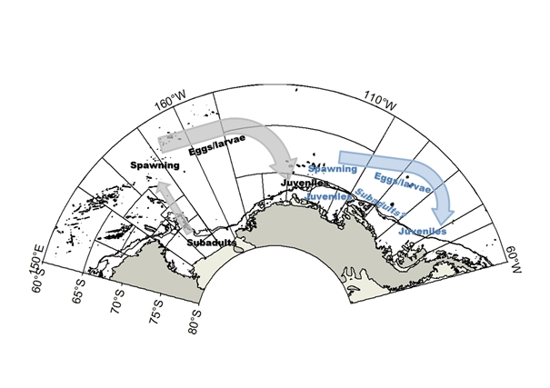
Ross Sea region Antarctic toothfish (TOA) (1 / 2)
Antarctic toothfish (Dissostichus mawsoni; TOA): Economically-important large-bodied species of family Nototheniidae, endemic to Antarctic and sub-Antarctic waters
Key ecological feature: Ontogenetic spatial distribution patterns (Hanchet et al., 2008):
Juveniles and young adults recruit to the Ross Sea region (RSR) shelf (i.e., at depths less than 800 m)
Antarctic toothfish undertake ontogenetic migrations, i.e., move into deeper waters as they grow older
Spawning takes place in the north, on seamounts, ridges and banks, in winter likely between mid-July and August (Hanchet et al., 2010; Parker et al., 2019)
The eggs and larvae of Antarctic toothfish are then transported by the Ross Sea gyre to the RSR shelf
RSR Antarctic toothfish is considered an enclosed unit stock centred on the Ross Sea gyre, based on stock structure analyses (Parker et al., 2014)
Hypothesized biological structure for Antarctic toothfish stocks in the Ross Sea region (black text and grey arrows) and Amundsen Sea region (blue text and arrows). Eggs/larvae (<30 cm), juveniles (30–80 cm), subadults (80–120 cm), spawning (>120 cm). Italics indicate uncertain distribution (Fig. 10 from Parker et al., 2014)

Slide 5
Ross Sea region Antarctic toothfish (TOA) (2 / 2)
Bottom longline is the only fishery that has operated in RSR since 1997
Fishing takes place in summer. Starts on the 1st December each year in the north, progresses south as sea ice retreats, and stops when the catch limit is reached (typically in January–February; Grüss et al., 2021a)
Important event in RSR was the establishment of the Ross Sea region Marine Protected Area (“RSrMPA”), adopted in 2016 and came into effect in the 2018 fishing season (CCAMLR-XXXVI, 2017) – This resulted in a re-definition of management areas in the RSR (see the map here)
Management areas in the RSR:
General Protection Zones (GPZ) (i)–(iii), where fishing is not permitted
Special Research Zone (SRZ), where fishing is permitted at a low exploitation rate
N70 (North of 70° S) management area
S70 (South of 70° S) management area
Also note:
Krill Research Zone (KRZ), part of RSrMPA, but there has never been any commercial longlining there
Depth contour plotted at 800 m

Slide 6
Operating model for TOA

Slide 7
Operating model (OM) for TOA (1 / 2)
Operating model (OM) uses the Spatial Population Model (SPM)
Originally developed for TOA, and later also used for Indian Ocean yellowfin tuna and holothurians of the Chatham Rise in New Zealand
Latest published version of the SPM for TOA is described in Mormede et al. (2014)
SPM for TOA updated to 2021 by Sophie Mormede. But NOT a model for management purposes, solely for modelling exercises
A specific management area was assigned to each SPM grid cell (simplification) – Management areas in this project do not reflect the real-world management areas (e.g., GPZ)
Spatial grid of the SPM:
(equal area squares)
(a)
Cells considered to be suitable habitat for TOA in yellow
(b)
Cells within the General Protection Zones (GPZ) in blue
Cells within the Special Research Zone (SRZ) in green
Cells within the N70 management area in orange
Cells within the S70 management area are in yellow

Slide 8
Operating model (OM) for TOA (2 / 2)
OM provided spatially-explicit data – not all of the data were used in the stock assessment models:
(1) Total catches in biomass, for each year of the period 1998–2021- USED in the stock assessment models
(2) Catches-per-unit-effort (CPUEs) in kg per 1000 hook, for each year of the period 1998–2021 – UNUSED
(3) Proportions-at-age of the catch, for each year of the period 2002–2020 – USED
(4) Proportions spawning for each length class in the catch, for each year of the period 2002–2020 – UNUSED
(5) Proportions-at-age of tagged and released fish, for each year of the period 2001–2020 – USED
(6) Proportions-at-age of fish recaptured with a tag, for each year of the period 2002–2020 – USED
Unused in the stock assessment model, because …
(2) Unused because never used in RSR Antarctic toothfish assessments - Changes in TOA CPUE are not consistent with likely “fish down” changes in TOA abundance and appear to partially reflect spatial management boundary changes, ice-driven availability on an annual basis, and continuing improvement in skill and fishing strategy by the fishing fleet rather than underlying abundance (Grüss et al., 2021c)
(4) Unused because never used in RSR Antarctic toothfish assessments (Grüss et al., 2021b)

Slide 9
Stock assessment models

Slide 10
Stock assessment models (1 / 4)
Implemented using the CASAL software package (Bull et al., 2012)
Standard assessment modelling platform in New Zealand, which was chosen because it:
(1) Has spatial capabilities:
(i) Areas-as-fleets models (like the models presented in the following)
(ii) Spatially-explicit models, with migrations between regions
Most spatially-explicit stock assessments in New Zealand assume natal fidelity, i.e., fish spawned from a given stock will return to their natal spawning ground
(2) Can account for tag releases and recaptures by age or length
Examples of spatial stock assessment models implemented with CASAL:
(1) RSR Antarctic toothfish (Grüss et al., 2021b) – areas-as-fleets model, where tagging data are critical data inputs
(2) Kahawai – areas-as-fleets models
(3) SNA1 (snapper from Northeast Coast North Island) – spatially-explicit model with three regions, three stocks, and natal fidelity with periods of mixing
(4) Hoki – spatially-explicit model with four regions, two separate spawning stocks, and natal fidelity model with separate stock spawning grounds

Slide 11
Stock assessment models (2 / 4)
Our one-area and four-area models are for one single region
Our four-area models account for some spatial structure by estimating separate fishing selectivities for the different management areas of the RSR, using the “areas-as-fleets” approach (Punt, 2019)
Unsexed models, while the RSR Antarctic toothfish assessment model is a sexed model – because the OM provided only unsexed data
Age structured models considering ages 2 to 30+ – because the OM provided data for those specific age classes
Follow tag cohorts through time, specifically 20 tag cohorts that correspond to tag releases in years 2001 to 2020
Represent dynamics in years 1995 to 2021
Divide each year into three time steps, including summer (November-April), winter (May-October), and an age-incrementation time step – because of TOA ecology and fishery specifics
In Time-step 1, recruitment takes place, then tag releases and tag recaptures
Next, half of the natural mortality is applied (in Time-step 1), then instantaneous fishing mortality (in Time-step 1), then half of the natural mortality (in Time-step 2)
Spawning takes place at the end of Time-step 2
Spawning stock biomass (SSB) is recorded after half of the natural mortality has been applied in Time-step 2

Slide 12
Stock assessment models (3 / 4)
The models include the following areas-as-fleets:
One-area model: RSR (Ross Sea region)
Four-area model: N70, S70, SRZ (Special Research Zone), and GPZ (General Protection Zones)
For each fleet:
Selectivity-at-age is assumed to follow a capped double-normal distribution, and the parameters of the selectivity-at-age functions are estimated
The selectivity-at-age parameters of the one-area model are estimated using the same priors as the main fleet of the four-area model (S70)
Annual catches are defined, a maximum fishing pressure of 0.999 is assumed, catch limit penalties are implemented (note that fish tagged penalties are also implemented)
Proportions-at-age and input sample sizes are provided
Multinomial distribution used, input sample sizes reweighted using Francis (2011)’s TA1.8 method
Tag releases and recaptures:
For each year of 2001-2020, total number of tag releases and proportions tagged at age are provided
For each year of 2002-2020, proportions scanned at age and proportions recaptured at age are specified
In-year recaptures are ignored, only the tags that have been at liberty for a maximum of 6 years are considered
A quasi-Binomial distribution was used for the tag-recapture data, and the dispersion term for the tag-recapture likelihood was initially set to 1.0 and was reweighted using the “Reweight.tags” function from R package “DataWeighting” (Francis, 2015)

Slide 13
Stock assessment models (4 / 4)
Recruitment process:
Fish recruit at age 2 (https://aaronmberger-nwfsc.github.io/Spatial-Assessment-Modeling-Workshop/articles/OM_Description_TOA.html )
Recruitment is given by mean (unfished) recruitment (R0) multiplied by the Beverton-Holt spawning stock-recruitment relationship, where R0 is estimated
Steepness parameter set to 0.75 (https://aaronmberger-nwfsc.github.io/Spatial-Assessment-Modeling-Workshop/articles/OM_Description_TOA.html)
Year class strengths (YCS’s) in 1993-2019 are estimated
Maturation process:
Applied in Time-step 2; and maturation is specified as the time-invariant proportion of fish at age that are mature, using a logistic function and the parameters from Parker and Marriott (2012)
Natural mortality and growth and length-weight parameters all taken from https://aaronmberger-nwfsc.github.io/Spatial-Assessment-Modeling-Workshop/articles/OM_Description_TOA.html

Slide 14
Results of Objective 1
Objective 1: Using one single representative dataset, document the model building decision process at each stage of model development

Slide 15
Results of Objective 1 (1 / 11)
Workshop Objective 1 addressed with Replicate #2
One-area and four-area CASAL models run both in the Maximum Posterior Density (MPD) and Markov Chain Monte Carlo (MCMC) modes
Diagnostics examined – See the “extra slides” at the bottom of this presentation:
Pearson residuals of the proportions-at-age, expected and observed proportions-at-age for the different fleets, bubble plots of the Pearson age residuals
Boxplots of the observed age frequencies in the different fleets shown together with maximum MPD fits, trend in the 90th percentile of the observed age frequency in the different fleets shown together with MPD fit
Observed versus expected number of tags recaptured by tag recapture year for each tag release year
Observed versus expected number of tags recaptured by tag recapture year for each tag release year
Observed versus expected median ages of tag recaptures for each tag release year
Expected minus observed number of tagged fish recaptured each year per year of release
Pearson tag recapture residuals
MCMC posterior trace plots, MCMC diagnostics
MCMC predicted median ages vs. and observed median ages in the catch in the different fleets

Slide 16
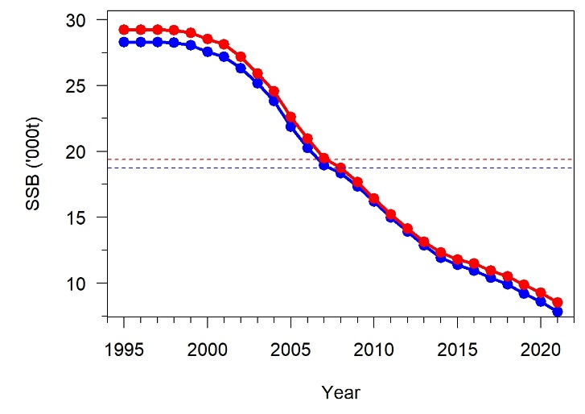
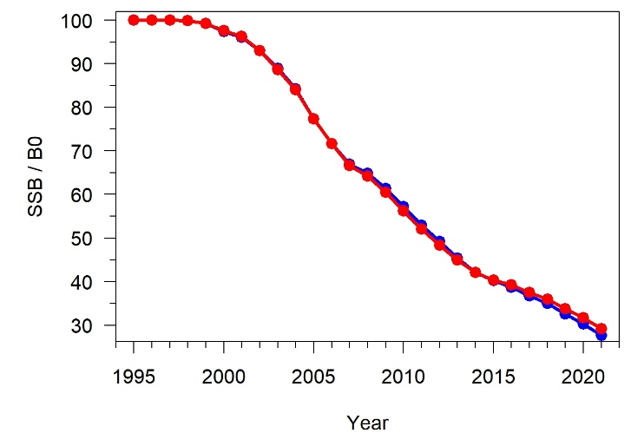
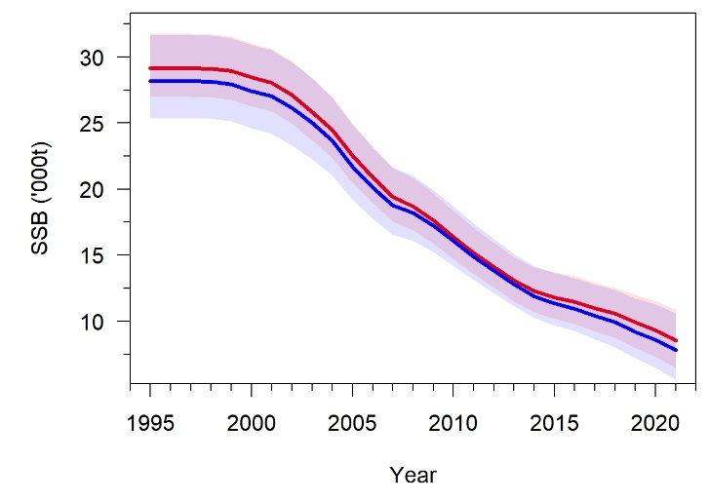
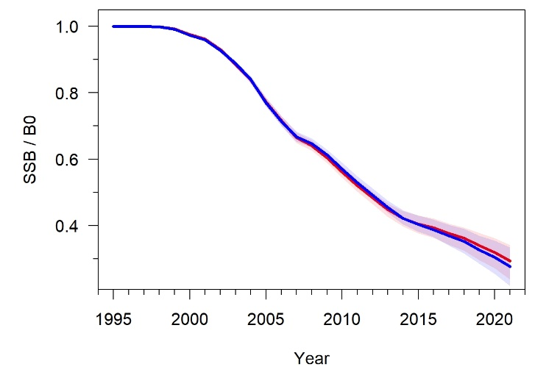
Results of Objective 1 (2 / 11)
SSBs, Initial SSB (B0), initial recruitment (R0), current SSB (B2021), and current stock status (B2021 over B0) are all slightly higher for the four-area model than for the one-area model
MPD results
MPD results
 | Four-area model | One-area model
B0 (t) | 29 223 | 28 287
R0 (number of fish) | 522 015 | 505 293
B2021 (t) | 8539 | 7817
B2021 / B0 | 0.292 | 0.276
MCMC results

Slide 17
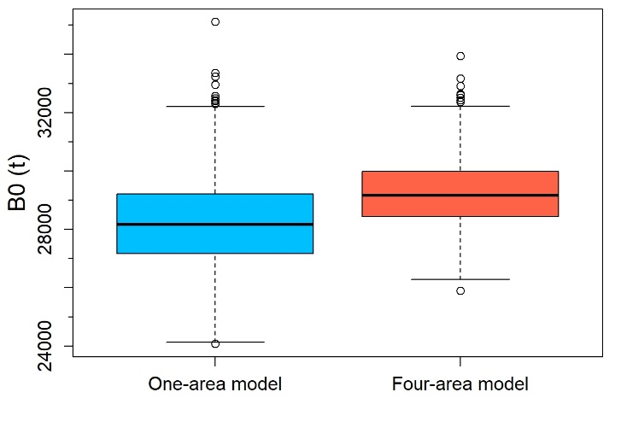
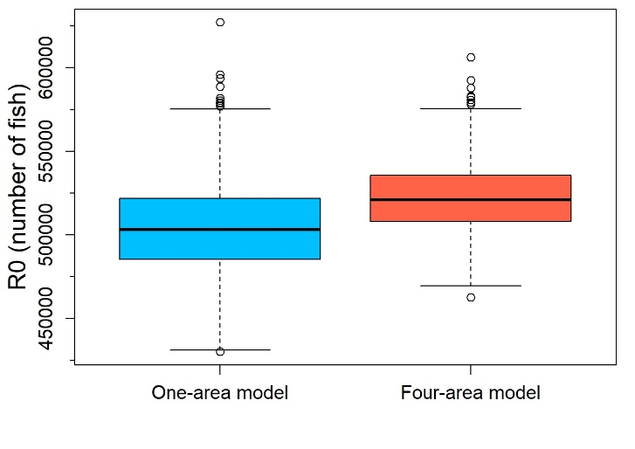
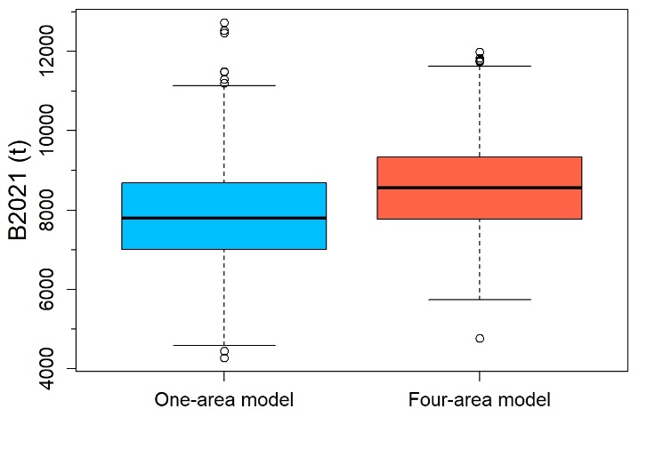
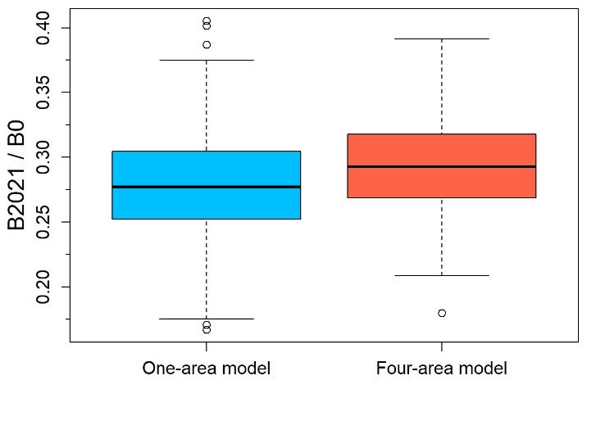
Results of Objective 1 (3 / 11)
Looking at MCMC results, we can observe that B0, R0, B2021 and current stock status (B2021 over B0) are all slightly higher for the four-area model than for the one-area model, but are also less uncertain for the four-area model
(Although one can interpret that the four-area and one-area models estimated a similar current stock status (B2021 over B0) for TOA )

Slide 18
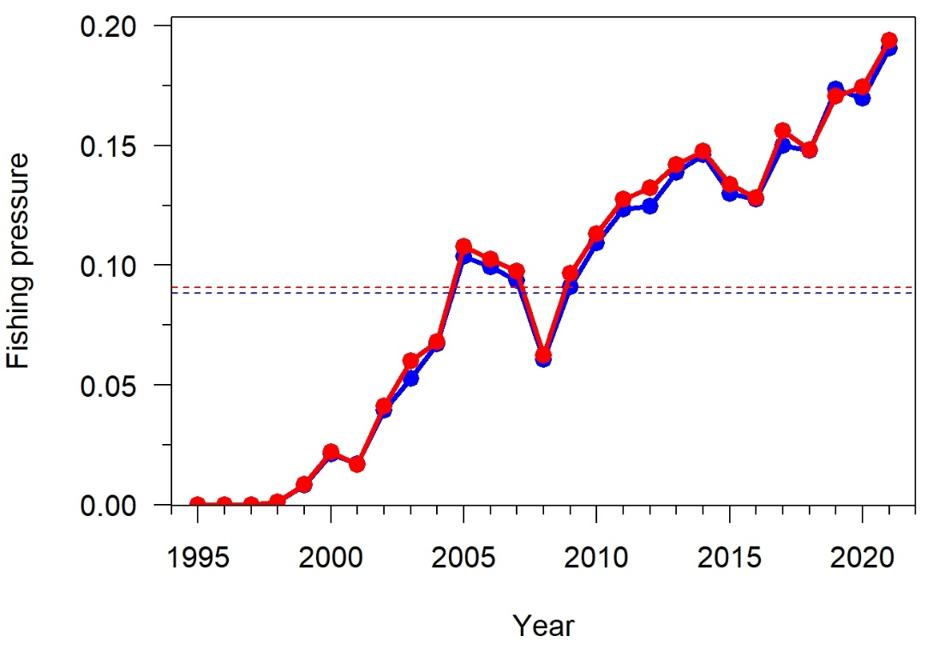
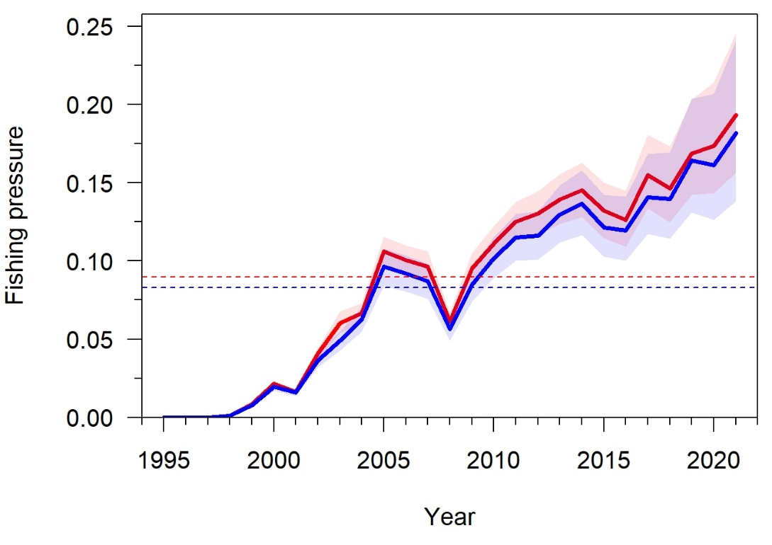
Results of Objective 1 (4 / 11)
The four-area model usually estimated slightly higher annual fishing pressures than the one-area model
MPD results
MCMC results

Slide 19
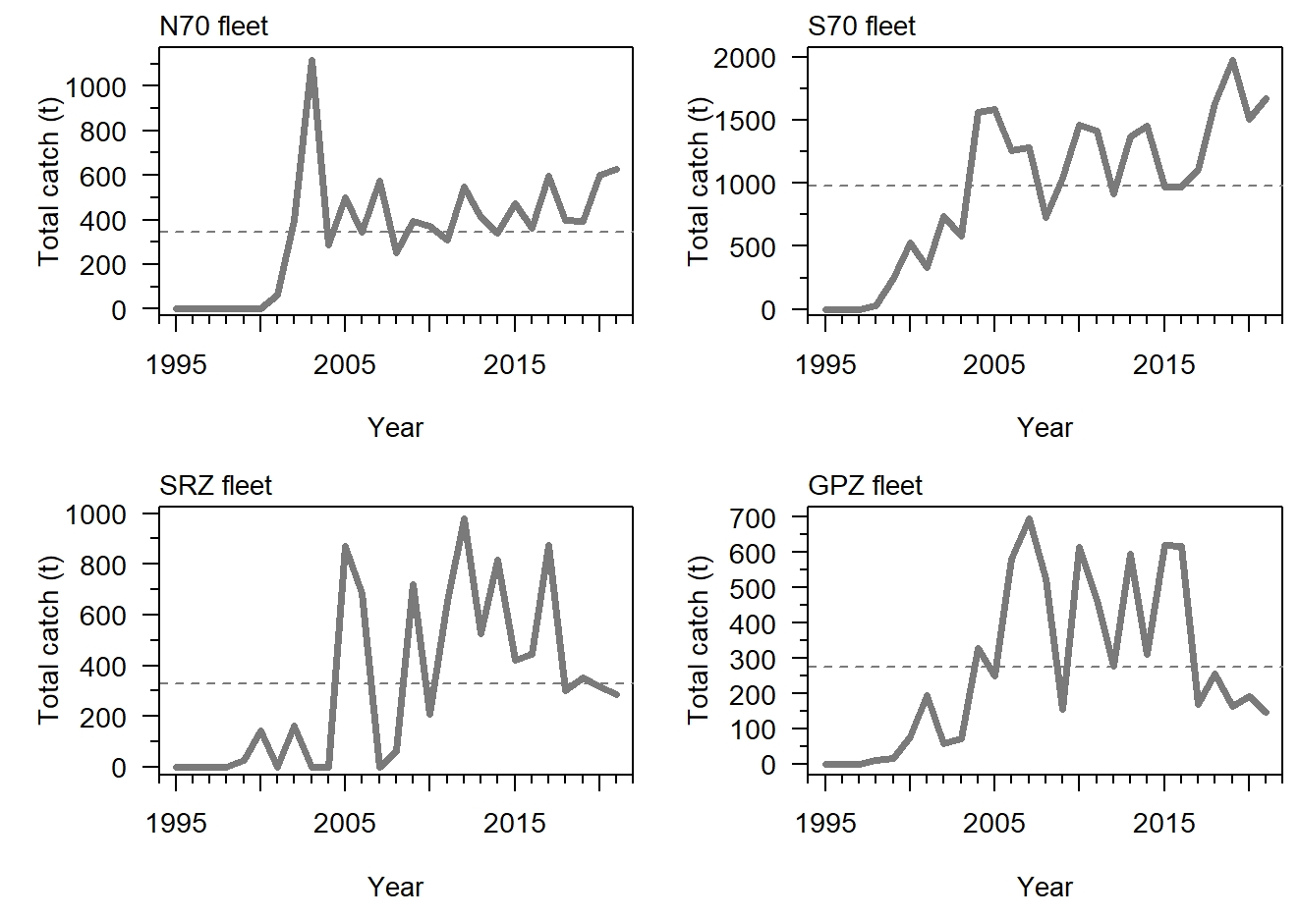
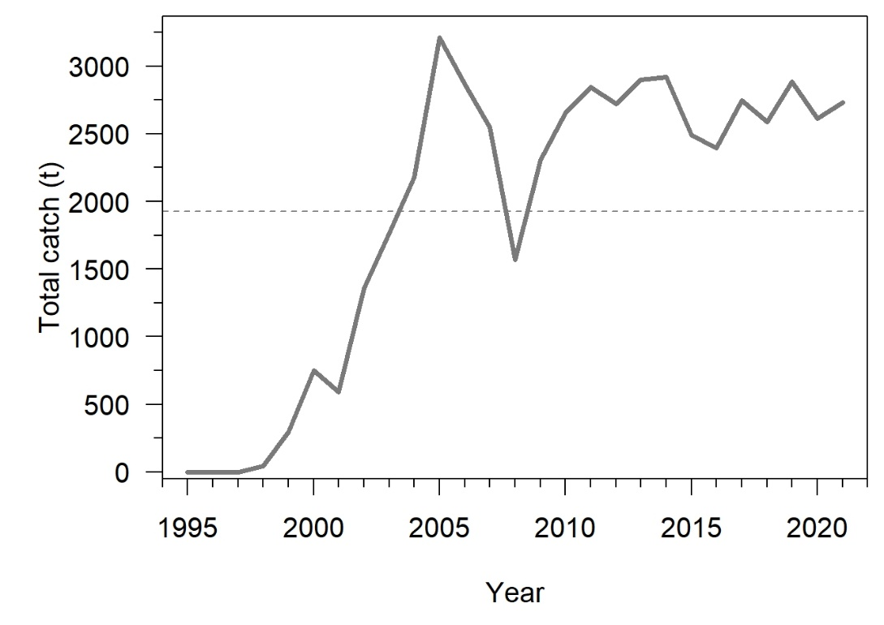
Results of Objective 1 (5 / 11)
The trends in total catch for the RSR fleet (one-area model) are similar to the trends in total catch for the S70 fleet (main fleet in the four-area model): Increase between 1997 and 2021 that reflects the tendency for fishing effort to have concentrated on the RSR Slope since the inception of the longline fishery
In recent years, the slight increase in total catch for the N70 fleet mirrors the decrease in total catch for the GPZ and SRZ fleets
Four-area model
One-area model

Slide 20
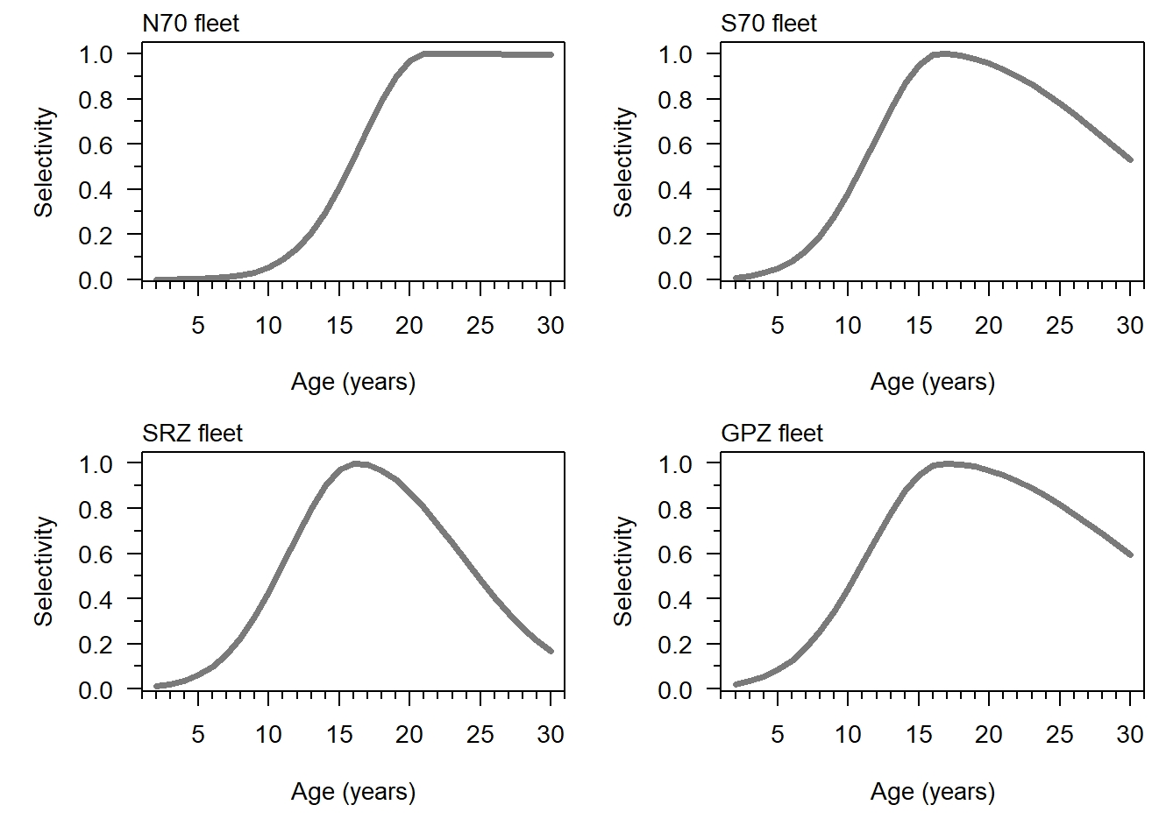
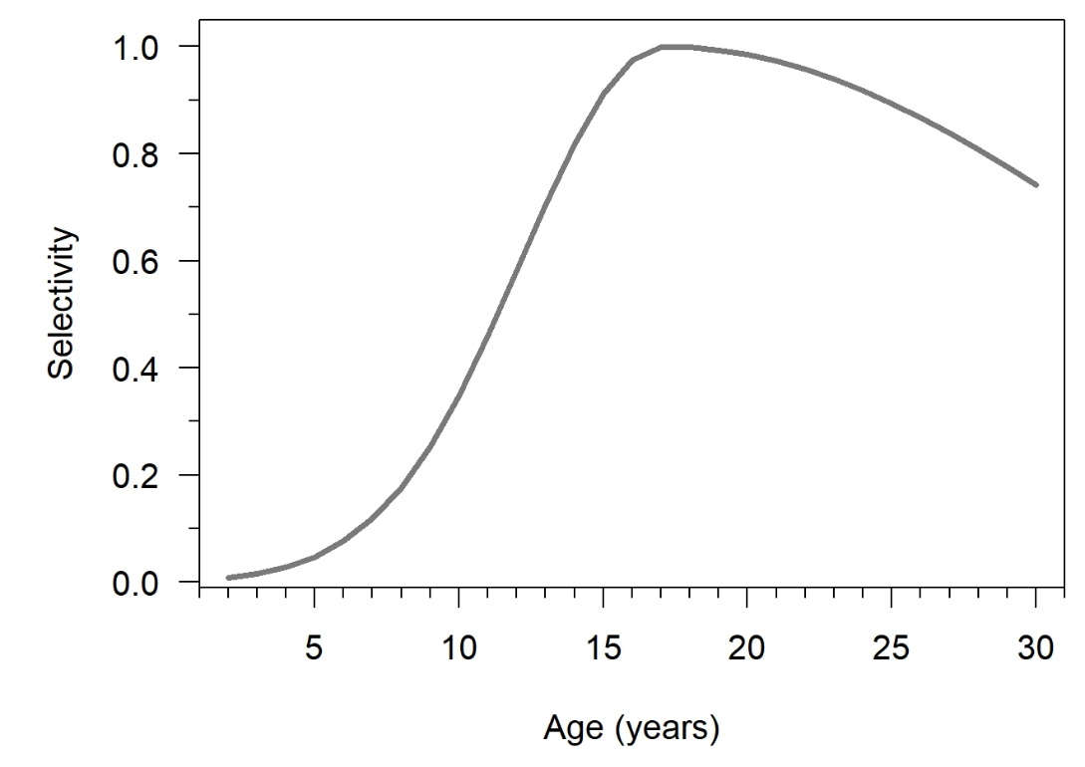
Results of Objective 1 (6 / 11)
Estimated selectivity function for the RSR fleet (one-area model) similar to estimated selectivity function for the S70 fleet (main fleet in the four-area model): dome-shaped, as for the SRZ and GPZ fleets
Estimated selectivity function the N70 fleet is different: Flat-topped, i.e., the oldest TOA individuals, which are found in the north of the RSR, are fully selected
MPD results for the four-area model
MPD results for the one-area model

Slide 21
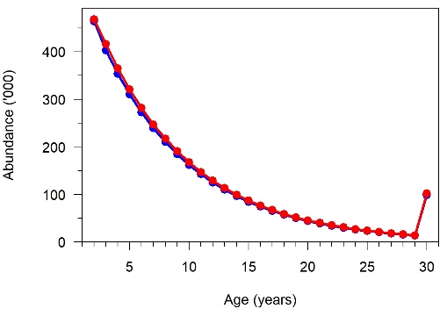
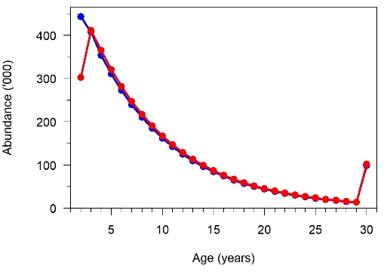
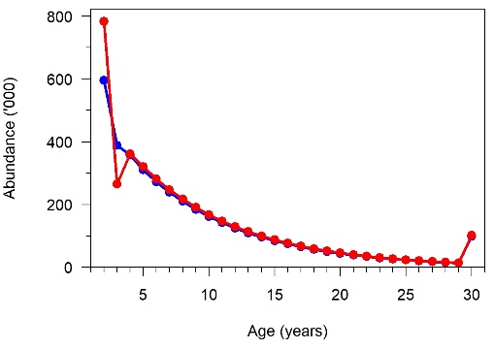
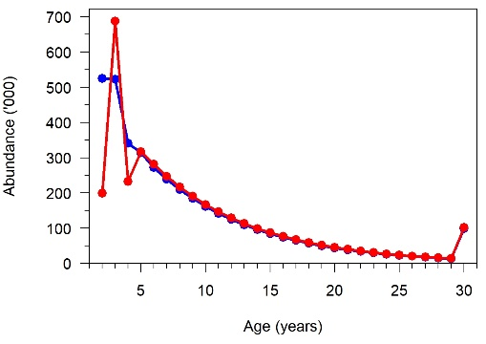
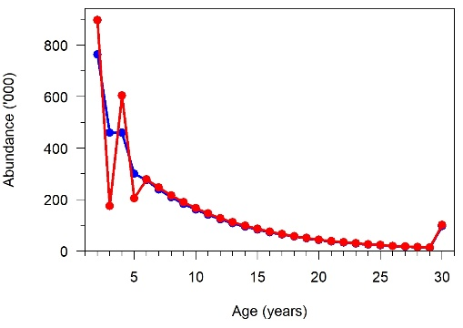
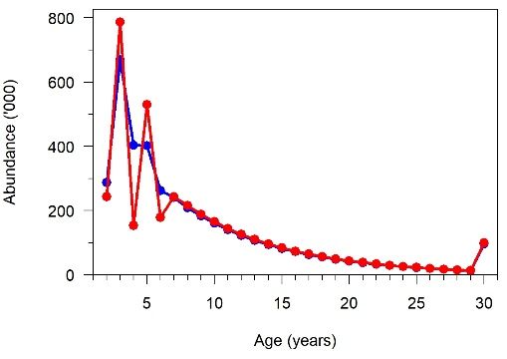
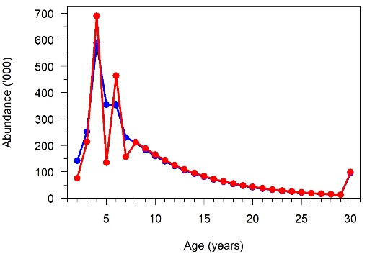
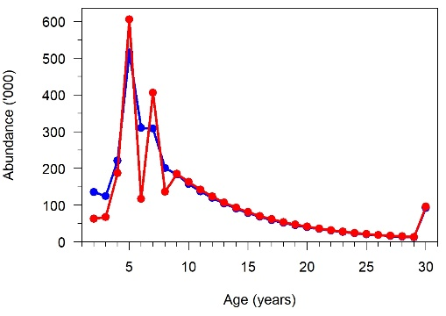
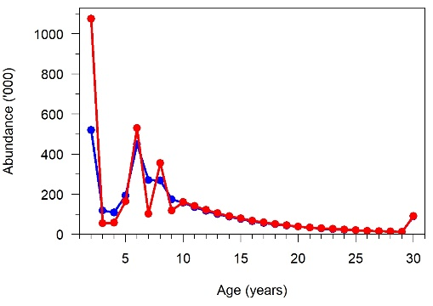
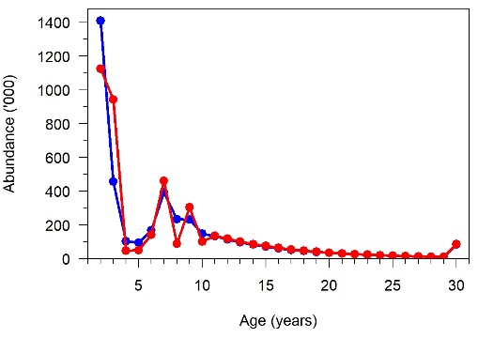
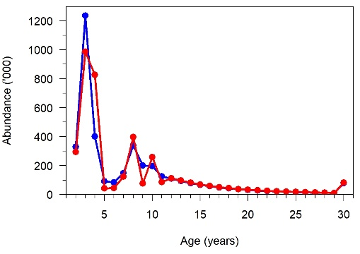
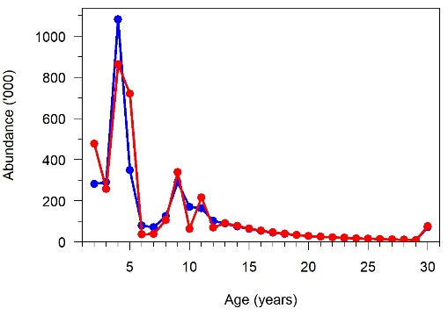
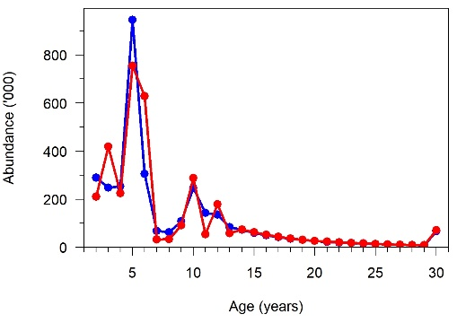
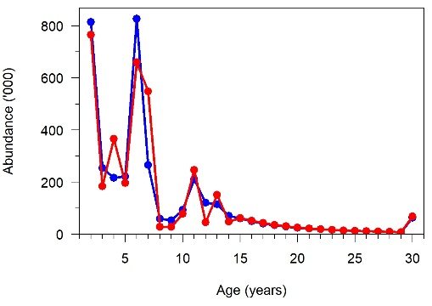
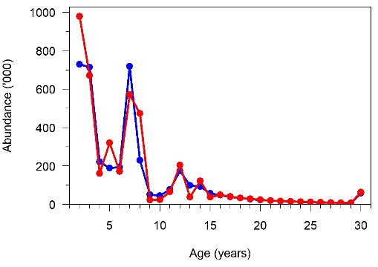
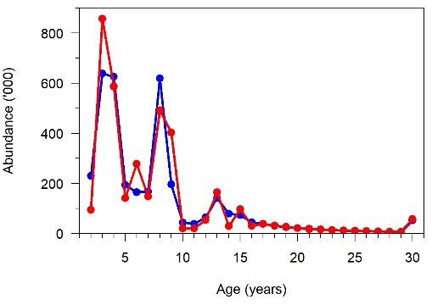
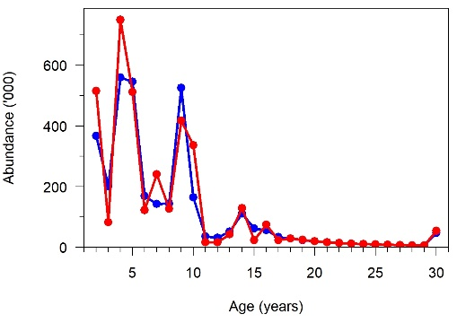
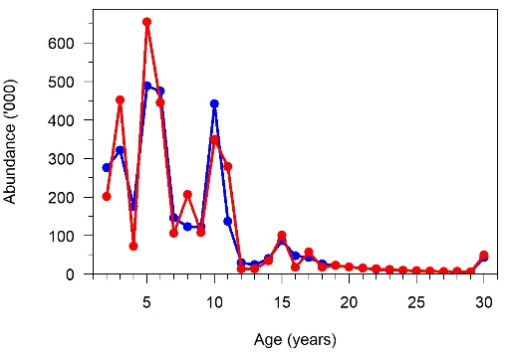
Results of Objective 1 (7 / 11)
Looking at MPD results, we can note differences in abundances-at-age between the four-area and the one-area models, especially more variability in age structure for the younger ages (< 15-year-old) in the four-area model
1995
1996
1997
1998
1999
2000
2001
2002
2003
2004
2005
2006
2007
2008
2009
2010
2011
2012

Slide 22
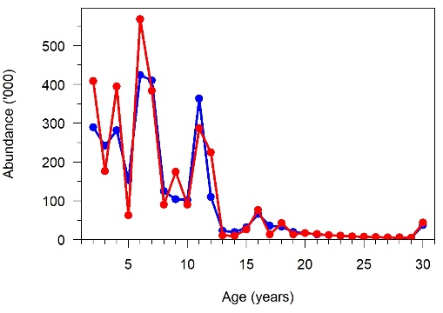
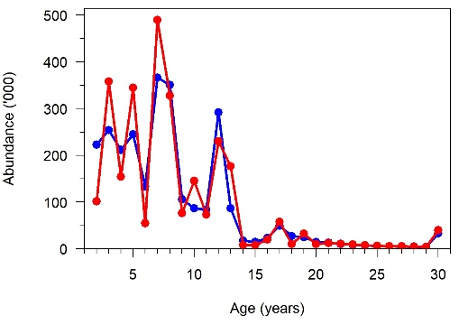
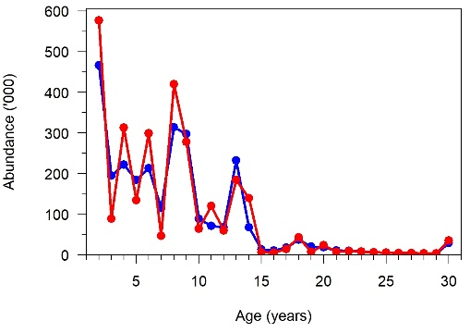
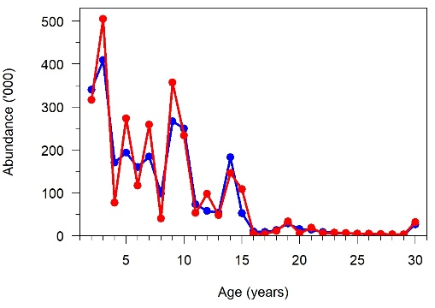
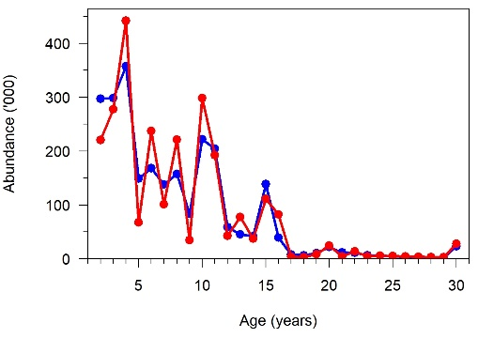
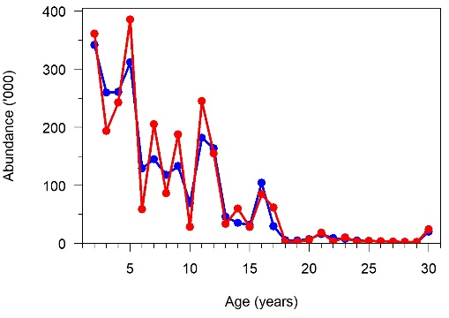
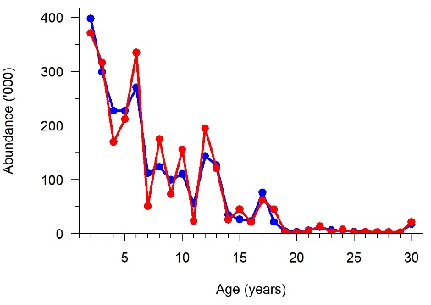
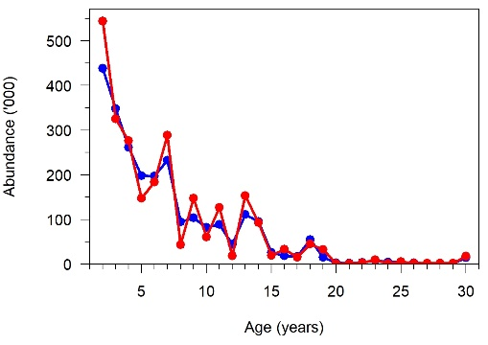
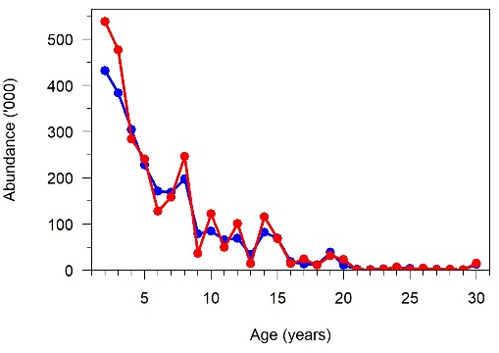
Results of Objective 1 (8 / 11)
Looking at MPD results, we can note differences in abundances-at-age between the four-area and the one-area models, especially more variability in age structure for the younger ages (< 15-year-old) in the four-area model
2013
2014
2015
2016
2017
2018
2019
2020
2021

Slide 23
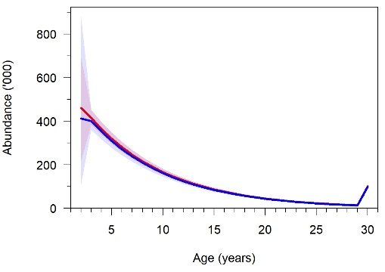
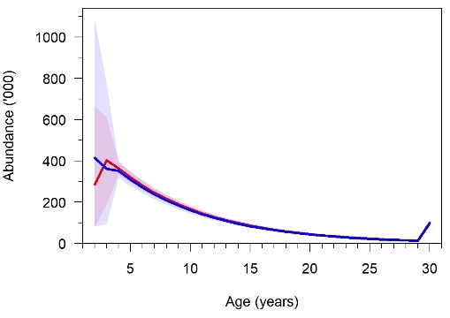
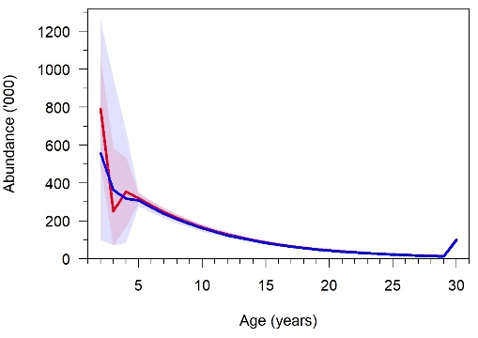

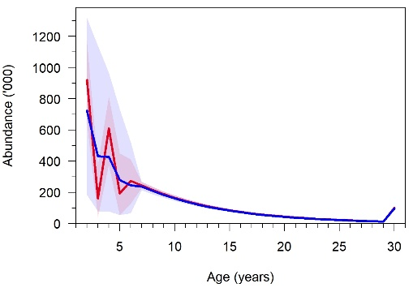
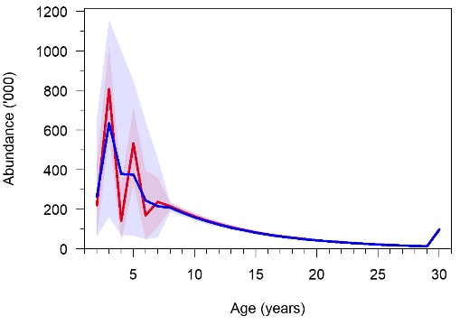
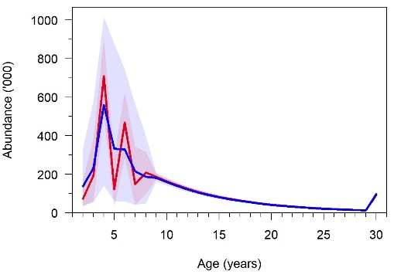
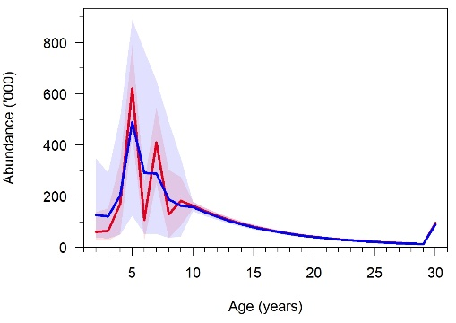
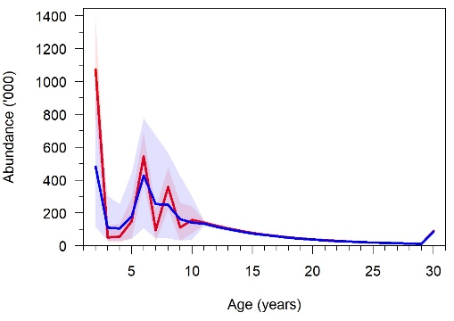









Results of Objective 1 (9 / 11)
Looking at MCMC results, we can note more variability in age structure for the younger ages (< 15-year-old) in the four-area model …
… but more uncertainty in the estimated age structure in the one-area model
1995
1996
1997
1998
1999
2000
2001
2002
2003
2004
2005
2006
2007
2008
2009
2010
2011
2012

Slide 24









Results of Objective 1 (10 / 11)
Looking at MCMC results, we can note more variability in age structure for the younger ages (< 15-year-old) in the four-area model …
… but more uncertainty in the estimated age structure in the one-area model
2013
2014
2015
2016
2017
2018
2019
2020
2021

Slide 25


Results of Objective 1 (11 / 11)
Age structure results can be explained by looking at YCS results
Estimated YCS’s have more interannual variability but are less uncertain for the four-area model compared to the one-area model
MPD results
MCMC results

Slide 26
Results of Objective 2
Objective 2: Summarise the results across all 100 model runs for each model parameterisation and develop comparison graphics/metrics to compare performance across the one-area and four-area models

Slide 27
Results of Objective 2 (1 / 8)
Workshop Objective 2 addressed with the 100 replicates
Diagnostics and analyses conducted for Objective 1 also conducted for Objective 2
However, only MPD runs for Objective 2 - MCMC runs for the four-area model developed for Objective 1 took around 14 hours, and MCMC runs for the one-area model developed for Objective 1 took many hours
Analyses conducted over the 100 replicates:
(1) We compared the following predictions of the one-area and four-area models: SSB, stock status (SSB / B0), fishing pressure, age structure in select years (2014, 2017 and 2021) and YCS
(2) We also produced boxplots of B0, B2021, stock status (B2021 / B0) and R0 to compare the one-area and four-area models
Among all those quantities, R0 is the only quantity that is provided as input in the OM, i.e., we are able to determine bias in the estimated R0 for the four-area vs. the one-area model

Slide 28



Results of Objective 2 (2 / 8)
SSBs are higher for the four-area model than for the one-area model
Median fishing pressures (over the 100 replicates) tend to be very slightly higher for the four-area model than for the one-area model

Slide 29






Results of Objective 2 (3 / 8)
There are differences in the abundances-at-age estimated by the four-area and the one-area models, especially more variability in age structure for the younger ages (< 15-year-old) in the four-area model
2014
2017
2021
Median value over all replicates plus ranges of values
Median value over all replicates

Slide 30




Results of Objective 2 (4 / 8)
Age structure results can be explained by looking at YCS results
Looking at individual replicates, estimated YCS’s have more interannual variability with the four-area model compared to the one-area model – 4 examples here:

Slide 31



Results of Objective 2 (5 / 8)
Initial SSB (B0) higher for the four-area model than for the one-area model
Current SSB (B2021) very slightly higher for the four-area model than for the one-area model
Current status (B2021 / B0) similar for the four-area model and the one-area model

Slide 32


Results of Objective 2 (6 / 8)
The estimated initial recruitment (R0) is higher in the four-area model than in the one-area model
Contrary to other quantities (B0, B2021), R0 is estimated by the CASAL stock assessment models, but provided as input in the OM (R0 = 1 021 124; https://aaronmberger-nwfsc.github.io/Spatial-Assessment-Modeling-Workshop/articles/OM_Description_TOA.html)
→ We can, therefore, evaluate bias (in %) in the R0 estimated by the one-area and the four-area models:

Slide 33
Results of Objective 2 (7 / 8)
Why is it interesting to evaluate bias in R0?
In the stock assessment models, we are making the important assumption that the probability of recapturing a tagged fish is the same as that of an untagged fish, irrespective of the location at which tagged fish were released or the subsequent spatial distribution of fishing effort from which fish were scanned to detect recaptures
In other words, in the stock assessment models, we are assuming complete mixing of tagged and untagged fish
→ An assumption likely not met in the real world, because of the spatial management in place in the RSR, the influence of sea-ice extent on the spatial distribution of fishing vessels, and the fact that RSR Antarctic toothfish generally move over relatively short distances (Parker et al., 2013; Grüss et al., 2021a)

Slide 34

Results of Objective 2 (8 / 8)
Bias:
The R0 estimated by all stock assessment models (one-area and four-area) is biased low by more than 40% (considering the 100 replicates)
The negative bias is significantly lower for the four-area model than for the one-area model

Slide 35
Conclusions

Slide 36
Conclusions (1 / 2)
Compared with the one-area model, the four-area model:
Predicts slightly higher SSBs, B0, B2021 and annual fishing pressures
But predicts a similar current stock status
Allows for the estimation of several selectivity-at-age functions that account for the ontogenetic migration patterns in TOA
Estimates YCS’s that have more interannual variability and are less uncertain
As a result predicts more variability in age structure for the younger ages (< 15-year-old) and a less uncertain age structure
Slightly reduces bias and error in the estimated R0

Slide 37
Conclusions (2 / 2)
Avenues for future research:
Using Casal2 (Doonan et al., 2016) (to be used for the TOA assessment in 2023), possibly attempting to develop a spatially-explicit assessment model with migrations between regions
Improving the OM (Spatial Population Model), to later estimate biases in stock size for TOA to inform management – particularly introducing the Ross Sea Shelf Survey in the OM, so that the survey catch-at-age data provided by the OM can be used to estimate YCS’s with the stock assessment model
Inadequate mixing affects many applications of tagging data in stock assessments, and biases the estimates of mortality and abundance. The spatial scales of stock assessment regions are often incompatible with mixing assumptions, given the movement patterns of tagged fish. Tagging models that operate at finer spatial and temporal scales may help to address this issue for spatially-explicit assessment models (e.g., Thorson et al. 2021; draft model by Mildenberger et al., 2022)
These tagging models would allow for the introduction of parameters in spatially-explicit assessment models that would constrain those models
Not our area of expertise, people like Mark Maunder may be able to tell the workshop participants more on this topic

Slide 38
References

Slide 39
References (1 / 2)
Bull, B., Dunn, A., McKenzie, A., Gilbert, D.J., Smith, M.H., Bian, R., Fu, D., 2012. CASAL (C++ algorithmic stock assessment laboratory) User Manual v2.30-2012/03/21. No. NIWA Technical Report 135. National Institute of Water and Atmospheric Research, Wellington, New Zealand. 280 pp.
CCAMLR-XXXVI, 2017. Report of the thirty-sixth meeting of the Commission. CCAMLR, Hobart, Australia.
Doonan, I., Large, K., Dunn, A., Rasmussen, S., Marsh, C., Mormede, S. (2016). Casal2: New Zealand’s integrated population modelling tool. Fisheries Research 183, 498–505.
Geweke, J. (1992). Evaluating the accuracy of sampling-based approaches to calculating posterior moments. In: Bernardo, J.M., Berger, J.O., Dawid, A.P., Smith, A.F.M. (Eds.). Bayesian Statistics, 4. Clarendon Press, Oxford, pp. 169–194.
Francis, R. I. C. C. 2011. Data weighting in statistical fisheries stock assessment models. Canadian Journal of Fisheries and Aquatic Sciences 68(6), 1124-1138.
Francis R. I. C. C. 2015. Data Weighting: Data Weighting package. R package version 1.0. Available from http://www.niwa.co.nz.
Grüss, A., Devine, J.A., Parker, S.J., 2021a. Characterisation of the toothfish fishery in the Ross Sea region through 2020/21. WG-FSA-2021/24. CCAMLR, Hobart, Australia. 37 pp.
Grüss, A., Dunn, A., Parker, S.J., 2021b. Assessment model for Antarctic toothfish (Dissostichus mawsoni) in the Ross Sea region to 2020/21. WG-FSA-2021/26. CCAMLR, Hobart, Australia. 20 pp.
Grüss, A., Dunn, A., Parker, S.J., 2021c. Stock Annex for the 2021 assessment of Ross Sea region Antarctic toothfish (Dissostichus mawsoni). WG-FSA-2021/28. CCAMLR, Hobart, Australia. 14 pp.
Hanchet, S.M., Mormede, S., Dunn, A., 2010. Distribution and relative abundance of Antarctic toothfish (Dissostichus mawsoni) on the Ross Sea shelf. CCAMLR Science 17, 33–51.
Hanchet, S.M., Rickard, G.J., Fenaughty, J.M., Dunn, A., Williams, M.J., 2008. A hypothetical life cycle for Antarctic toothfish (Dissostichus mawsoni) in the Ross Sea region. CCAMLR Science 15, 35–53.

Slide 40
References (2 / 2)
Heidelberger, P., Welch, P. (1983). Simulation run length control in the presence of an initial transient. Operations Research 31, 1109–1144.
Mildenberger, T. K., Nielsen, A., Maunder, M., 2022. Spatiotemporal tagging model for skipjack in the EPO. Document SAC-13-08.
Mormede, S., Dunn, A., Parker, S.J., Hanchet, S.M., 2014. Spatially explicit population dynamics models for Antarctic toothfish in the Ross Sea region. CCAMLR Science 21, 19–37.
Parker, S.J., Dunn, A., Mormede, S., Hanchet, S.M., 2013. Descriptive analysis of the toothfish (Dissostichus spp.) tagging programme in Subareas 88.1 & 88.2 for the years 2000–01 to 2012–13. WG-FSA-13/49. CCAMLR, Hobart, Australia. 35 pp.
Parker, S.J., Hanchet, S.M., Horn, P.L., 2014. Stock structure of Antarctic toothfish in Statistical Area 88 and implications for assessment and management. WG-SAM-14/26. CCAMLR, Hobart, Australia. 17 pp.
Parker, S.J., Marriott, P.M., 2012. Indexing maturation of Antarctic toothfish (Dissostichus mawsoni) in the Ross Sea region. WG-FSA-12/40. CCAMLR, Hobart, Australia. 21 pp.
Parker, S.J., Stevens, D.W., Ghigliotti, L., La Mesa, M., Di Blasi, D., Vacchi, M., 2019. Winter spawning of Antarctic toothfish Dissostichus mawsoni in the Ross Sea region. Antarctic Science 31, 243–253.
Punt, A.E., 2019. Spatial stock assessment methods: A viewpoint on current issues and assumptions. Fisheries Research 213, 132–143.
Thorson, J.T., Barbeaux, S.J., Goethel, D.R., Kearney, K.A., Laman, E.A., Nielsen, J.K., Siskey, M.R., Siwicke, K. and Thompson, G.G., 2021. Estimating fine-scale movement rates and habitat preferences using multiple data sources. Fish and Fisheries 22(6), 1359-1376.
https://aaronmberger-nwfsc.github.io/Spatial-Assessment-Modeling-Workshop/articles/OM_Description_TOA.html

Slide 41
Thank you very much for your attention
This project was partly supported by:
Fisheries New Zealand under project SEA2021-22
NIWA Strategic Science Investment Funding

Slide 42
Extra slides (1 / 4) – Diagnostics for the one-area model run in the MPD mode

Slide 43


Pearson residuals of the proportions-at-age

Slide 44























Expected (shaded areas) and observed (lines) proportions-at-age
1998
1999
2000
2001
2002
2003
2004
2005
2006
2007
2008
2009
2010
2011
2012
2013
2014
2015
2016
2017
2018
2019
2020

Slide 45

Pearson age residuals

Slide 46

Observed age frequencies versus predicted ages
Boxplots of the observed age frequencies in the RSR fleet (mean, interquartile, and 1.5 times the interquartile), and maximum posterior density (MPD) fits (mean in blue and interquartile in grey)

Slide 47

Observed 90th percentiles of the observed age frequencies versus MPD fits
Trend in the 90th percentile of the observed age frequency in the RSR fleet, and maximum posterior density (MPD) fit (blue line)

Slide 48



















Observed versus expected number of tags recaptured by recapture year
2001
2002
2003
2004
2005
2006
2007
2008
2009
2010
2011
2012
2013
2014
2015
2016
2017
2018
2019
Observed versus expected number of tags recaptured by tag recapture year for each tag release year

Slide 49


















Observed versus expected median ages of tag recaptures
2002
2003
2004
2005
2006
2007
2008
2009
2010
2011
2012
2013
2014
2015
2016
2017
2018
2019
Observed versus expected median ages of tag recaptures for each tag release year

Slide 50

Expected minus observed number of tagged fish recaptured each year per year of release
Expected minus observed number of tagged fish recaptured each year per year of release, with each tag release year indicated by the plot character (e.g., 1 = 2001 or 2011)

Slide 51



Pearson tag recapture residuals

Slide 52
Extra slides (2 / 4) – Diagnostics for the four-area model run in the MPD mode

Slide 53








Pearson residuals of the proportions-at-age
N70 fleet
S70 fleet
SRZ fleet
GPZ fleet

Slide 54




















Expected (shaded areas) and observed (lines) proportions-at-age for the N70 fleet
2001
2002
2003
2004
2005
2006
2007
2008
2009
2010
2011
2012
2013
2014
2015
2016
2017
2018
2019
2020

Slide 55






















Expected (shaded areas) and observed (lines) proportions-at-age for the S70 fleet
1998
1999
2000
2001
2002
2003
2004
2005
2006
2007
2008
2009
2010
2011
2012
2013
2014
2015
2016
2017
2018
2019
2020

Slide 56

















Expected (shaded areas) and observed (lines) proportions-at-age for the SRZ fleet
1999
2000
2002
2005
2006
2008
2009
2010
2011
2012
2013
2014
2015
2016
2017
2018
2019
2020

Slide 57























Expected (shaded areas) and observed (lines) proportions-at-age for the GPZ fleet
1998
1999
2000
2001
2002
2003
2004
2005
2006
2007
2008
2009
2010
2011
2012
2013
2014
2015
2016
2017
2018
2019
2020

Slide 58


Pearson age residuals (1 / 2)
N70 fleet
S70 fleet

Slide 59


Pearson age residuals (2 / 2)
SRZ fleet
GPZ fleet

Slide 60

Observed age frequencies versus predicted ages
Boxplots of the observed age frequencies in the N70, S70, SRZ and GPZ fleets (mean, interquartile, and 1.5 times the interquartile), and maximum posterior density (MPD) fits (mean in blue and interquartile in grey)

Slide 61

Observed 90th percentiles of the observed age frequencies versus MPD fits
Trend in the 90th percentile of the observed age frequency in the N70, S70 SRZ and GPZ fleets, and maximum posterior density (MPD) fit (blue line)

Slide 62


















Observed versus expected number of tags recaptured by recapture year
2001
2002
2003
2004
2005
2006
2007
2008
2009
2010
2011
2012
2013
2014
2015
2016
2017
2018
2019
Observed versus expected number of tags recaptured by tag recapture year for each tag release year

Slide 63


















Observed versus expected number of tags recaptured by age
2002
2003
2004
2005
2006
2007
2008
2009
2010
2011
2012
2013
2014
2015
2016
2017
2018
2019
Observed versus expected number of tags recaptured by age for each tag release year

Slide 64












Observed versus expected median ages of tag recaptures
2002
2003
2004
2005
2006
2007
2008
2009
2010
2011
2012
2013
2014
2015
2016
2017
2018
2019
Observed versus expected median ages of tag recaptures for each tag release year

Slide 65

Expected minus observed number of tagged fish recaptured each year per year of release
Expected minus observed number of tagged fish recaptured each year per year of release, with each tag release year indicated by the plot character (e.g., 1 = 2001 or 2011)

Slide 66



Pearson tag recapture residuals

Slide 67
Extra slides (3 / 4) – Diagnostics for the four-area model run in the MCMC mode

Slide 68

MCMC posterior trace plots (1 / 3)

Slide 69


MCMC posterior trace plots (2 / 3)

Slide 70

MCMC posterior trace plots (3 / 3)

Slide 71

MCMC diagnostics
MCMC posterior diagnostic plots, showing median relative jump size for all parameters (left), and autocorrelation lag plot for pre-exploitation biomass B0 (right)

Slide 72























Expected (dashed lines) and observed (full lines) proportions-at-age
1998
1999
2000
2001
2002
2003
2004
2005
2006
2007
2008
2009
2010
2011
2012
2013
2014
2015
2016
2017
2018
2019
2020

Slide 73

Median age fits
MCMC predicted (mean in continuous line and 95% confidence interval in dashed lines) and observed (dots) median ages in the commercial catch

Slide 74
Extra slides (4 / 4) – Diagnostics for the four-area model run in the MCMC mode

Slide 75

MCMC posterior trace plots (1 / 3)

Slide 76


MCMC posterior trace plots (2 / 3)

Slide 77


MCMC posterior trace plots (3 / 3)

Slide 78
MCMC diagnostics
MCMC posterior diagnostic plots, showing median relative jump size for all parameters (left), and autocorrelation lag plot for pre-exploitation biomass B0 (right)
selectivity[GPZsel].all.3
selectivity[GPZsel].all.4
selectivity[SRZsel].all.4
selectivity[S70sel].all.4
selectivity[N70sel].all.3
selectivity[N70sel].all.4

Slide 79




















Expected (dashed lines) and observed (full lines) proportions-at-age for the N70 fleet
2001
2002
2003
2004
2005
2006
2007
2008
2009
2010
2011
2012
2013
2014
2015
2016
2017
2018
2019
2020

Slide 80























Expected (dashed lines) and observed (full lines) proportions-at-age for the S70 fleet
1998
1999
2000
2001
2002
2003
2004
2005
2006
2007
2008
2009
2010
2011
2012
2013
2014
2015
2016
2017
2018
2019
2020

Slide 81

















Expected (dashed lines) and observed (full lines) proportions-at-age for the SRZ fleet
1999
2000
2002
2005
2006
2008
2009
2010
2011
2012
2013
2014
2015
2016
2017
2018
2019
2020

Slide 82























Expected (dashed lines) and observed (full lines) proportions-at-age for the GPZ fleet
1998
1999
2000
2001
2002
2003
2004
2005
2006
2007
2008
2009
2010
2011
2012
2013
2014
2015
2016
2017
2018
2019
2020

Slide 83




Median age fits
N70 fleet
S70 fleet
MCMC predicted (mean in continuous line and 95% confidence interval in dashed lines) and observed (dots) median ages in the commercial catch in the N70, S70, SRZ and GPZ fleets
SRZ fleet
GPZ fleet

